Slide 1
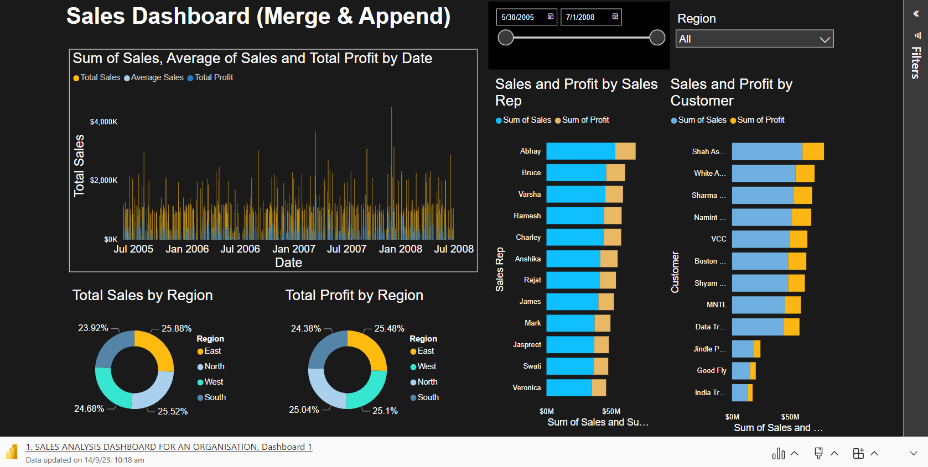
Sales Analytics Dashboard of an Organisation

